Slide 1
Section 6.6
Work

Slide 2
All graphics are attributed to:
Calculus,10/E by Howard Anton, Irl Bivens, and Stephen Davis
Copyright © 2009 by John Wiley & Sons, Inc. All rights reserved.

Slide 3
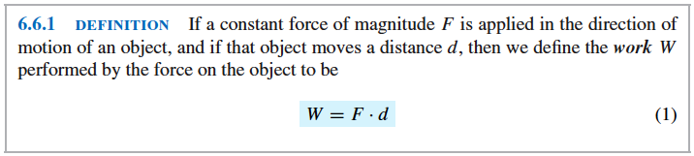
Introduction
In this section we will use our integration skills to study some basic principles of “work”, which is one of the fundamental concepts in physics and engineering.
A simple example:
  When you push a car that has run out of gas for a certain distance you are performing work and the effect of your work is to make the car move.
  The energy of motion caused by the work is called the kinetic energy of the car.
  There is a principle of physics called the work-energy relationship. We will barely touch on this principle.
  Our main goal (on later slides) is to see how integration is related.

Slide 4
Examples of W = F * d
An object moves five feet along a line while subjected to a constant force of 100 pounds in its direction of motion.
  The work done is W = F * d = 100 * 5 = 500 ft-lbs
An object moves 25 meters along a line while subjected to a constant force of four Newtons in its direction of motion.
  The work done is W = F * d = 4*25 = 100 N-m
  =100 Joules

Slide 5
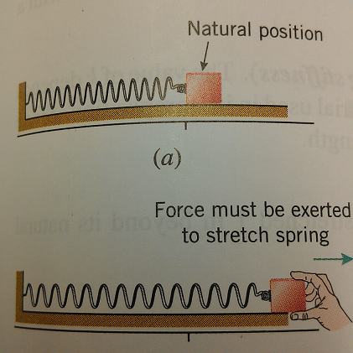
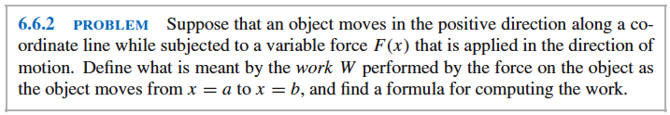
Work Done by a Variable Force Applied in the Direction of Motion
If we wanted to pull the block attached to the spring horizontally, then we would have to apply more and more force to the block to overcome the increasing force of the stretching spring.
We will break the interval of the stretch [a,b] into subintervals and approximate the work on each subinterval.
By adding the approximations to the work we will obtain a Riemann sum.
The limit of the Riemann sum as n increases will give us an integral for work W.

Slide 6
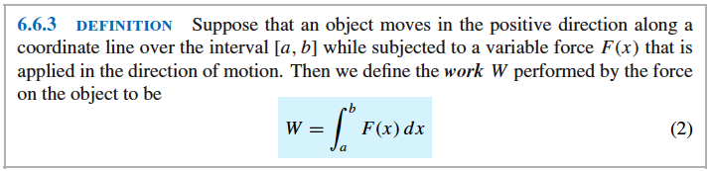
Integral for Work, W (with a Variable Force)

Slide 7
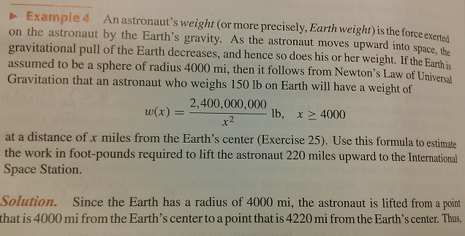
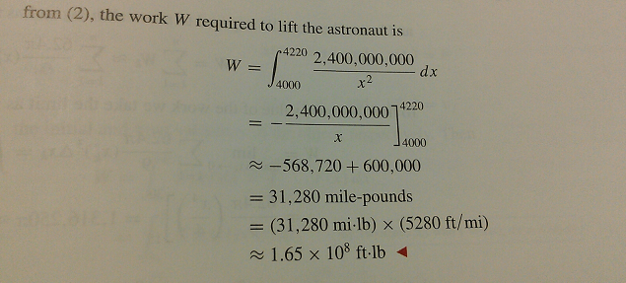
Example

Slide 8
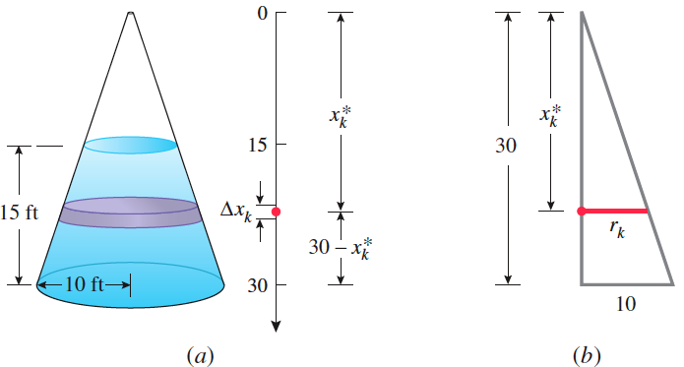
Calculating Work from Basic Principles Example
As you can see in the figure above right, we have a cone shaped (conical) container of radius 10 ft and height 30 ft. Suppose that this container is filled with water to a depth of 15 ft. How much work is required to pump all of the water out through the hole in the top of the container?
  We will divide the water into thin layers, approximate the work required to move each layer to the top of the container and add them to obtain a Riemann sum.
  The limit of the Riemann sum produces an integral for the total work.

Slide 9
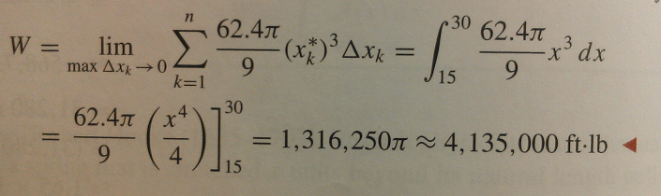
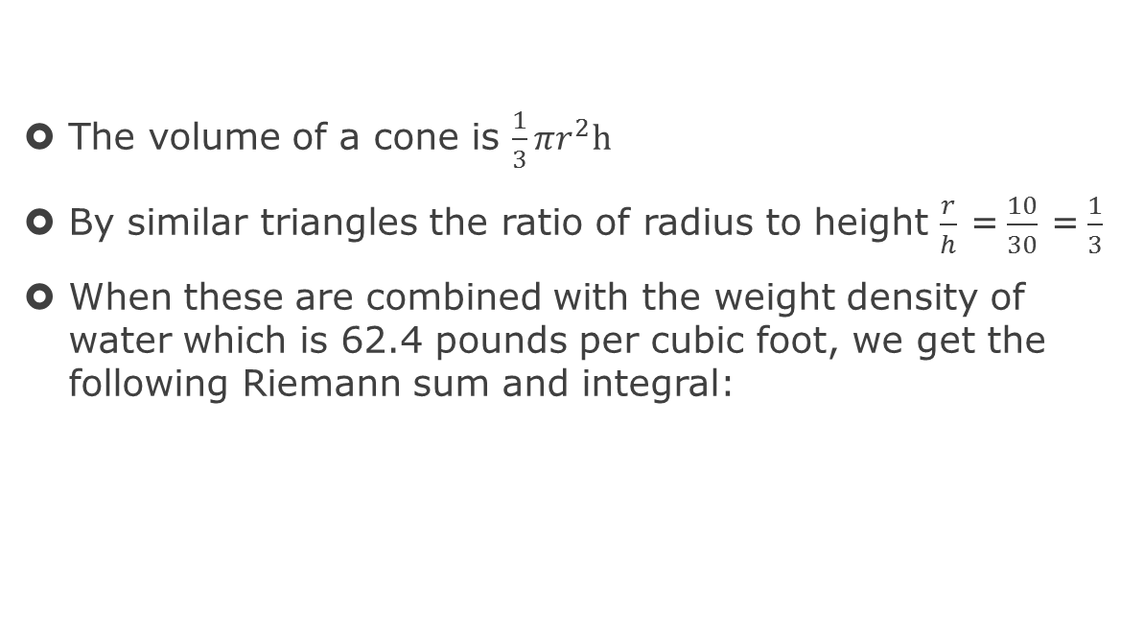
Calculating Work from Basic Principles Example con’t
The volume of a cone is $\frac{1}{3}πr^{2}h$
By similar triangles the ratio of radius to height $\frac{r}{h}$ =$\frac{10}{30}$ =$\frac{1}{3}$
When these are combined with the weight density of water which is 62.4 pounds per cubic foot, we get the following Riemann sum and integral:

Slide 10
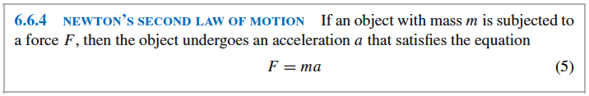

Slide 11

Chalk Art on the Street

